Slide 1

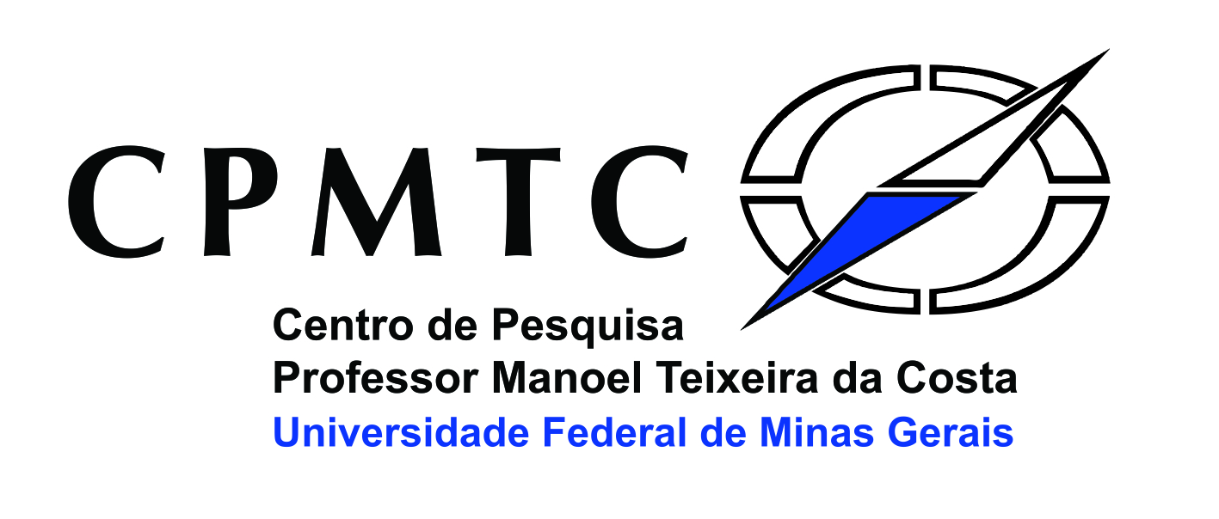
Depósitos Auríferos:
Modelos, evolução de descobertas e perspectivas
Lydia Maria Lobato
Dept. Geologia
Universidade Federal de Minas Gerais
14/05/2020
llobato.ufmg@gmail.com

Slide 2
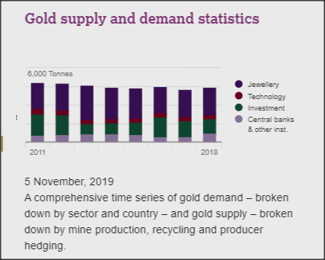

Gold → Au
Gold in the crust = 3.1 ppb → 3.1 units gold / 1,000,000,000 of total crust = 0.00000031% Au
To be economically viable as a deposit it needs = few g/t → 3 g / 1000 kg = 3 g/ 1,000,000 g = 0.00031% Au
Concentrate at least 1000-fold to be viable deposit
Rare mines can be up to a few % gold (extremely high grade)!

Slide 3
Mining of gold stretches back at least 6,000 years.
It is only in the last 125 years that hard-rock gold deposits other than orogenic and epithermal types have been worked.

Slide 5
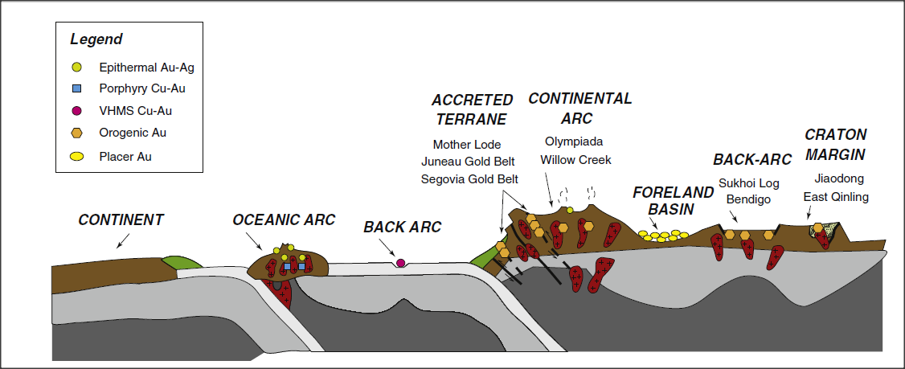
Depósitos de Ouro:
Ambientes
Classes
Distribuição
Idades
Tectonic Setting Gold-Rich Deposits
from Groves et al., 1998, in Goldfarb et al., 2005, Goldfarb and Groves (2015)

Slide 6
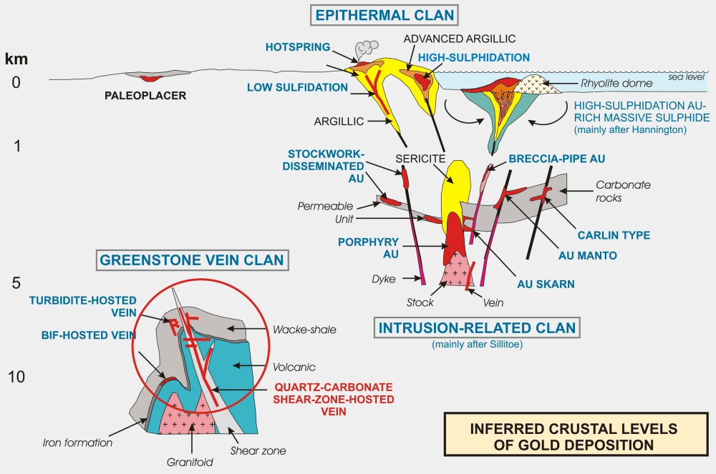
Tectonic Setting Gold-Rich Deposits
1a → hidrot. magmático + água meteórica
1b → hidrot. magmático* + f. metamórfico* + meteórica
1c → água do mar aquecida + hidrot. magmático*
1d → hidrot. magmático + meteórica + f. basinal*
2a → hidrot. metamórfico + magmático*
* : pode ou não ser detectado
2007
Inferred crustal levels of gold deposition showing the different types of gold deposits and the inferred deposit clan (from Dubé et al., 2001c; modified from Poulsen et al., 2000).

Slide 7
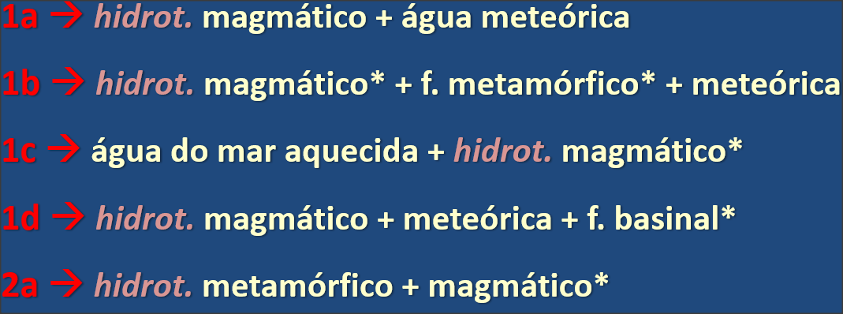
2007
1a
1a
1a
1a
1b
1c
Clástico & 2a
1d
Fattam .... IOCGs

Slide 8
2007
2a
2a
2a
1a
1a
1a

Slide 9
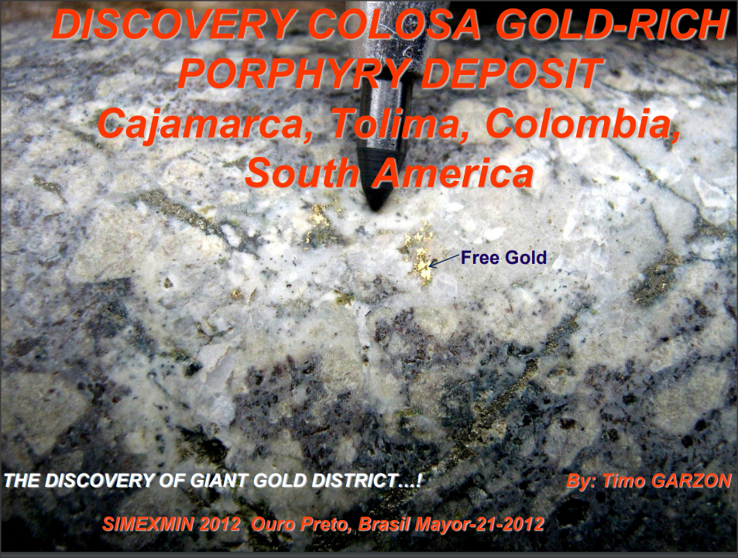
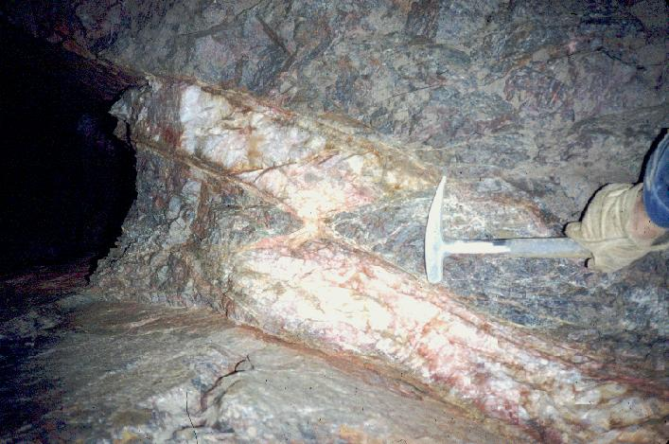
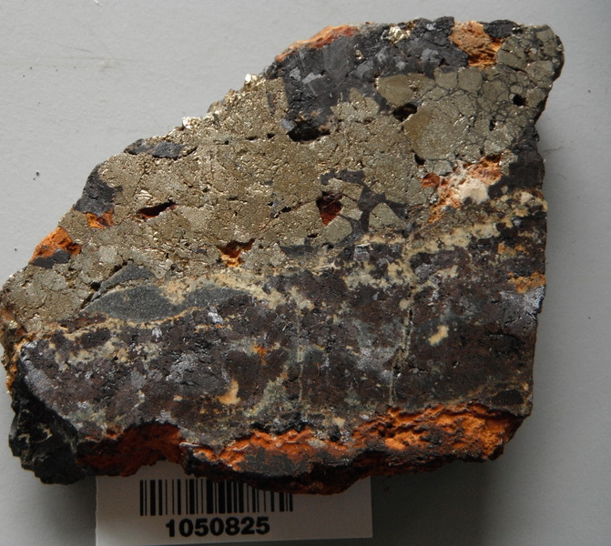
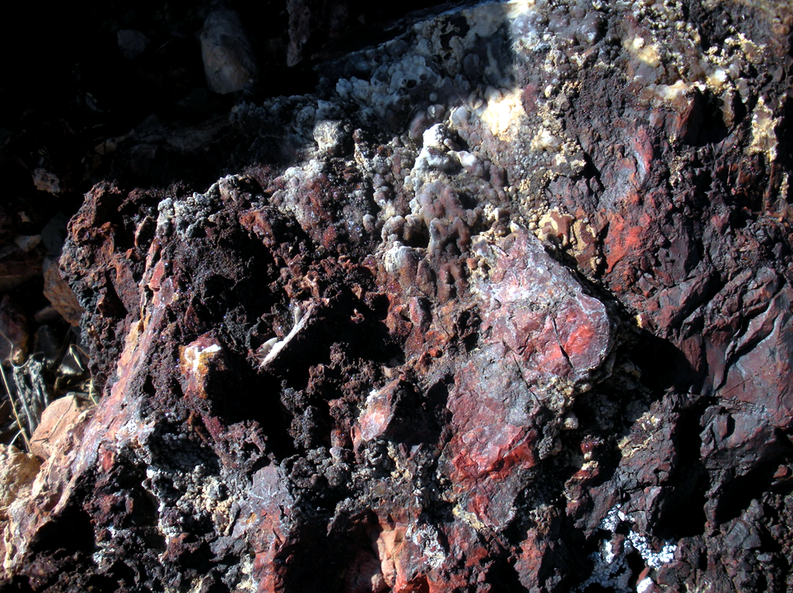
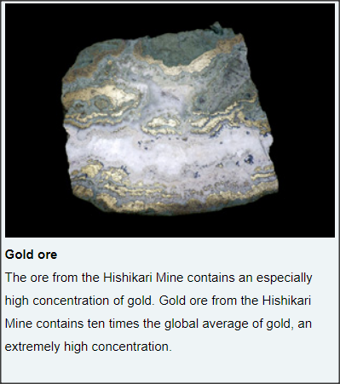
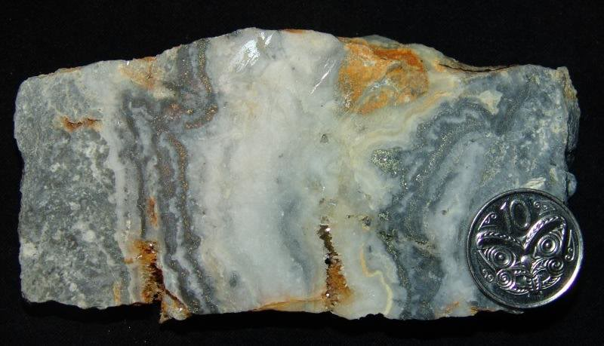
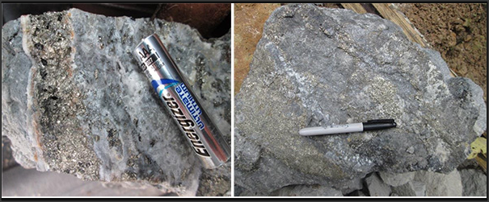
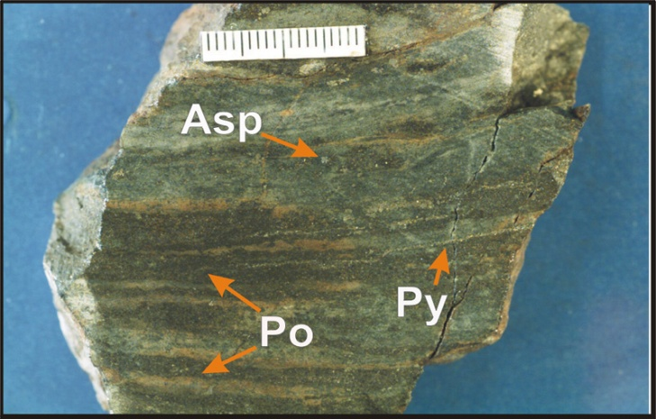
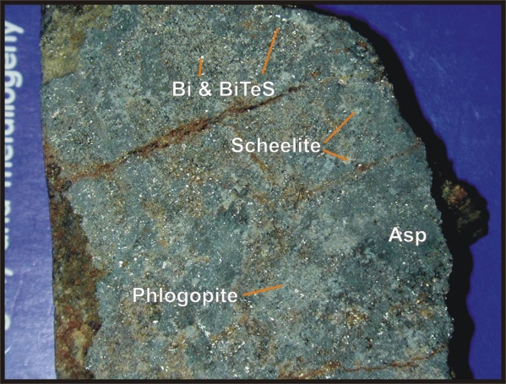
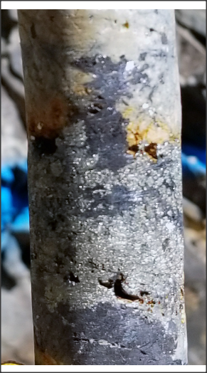
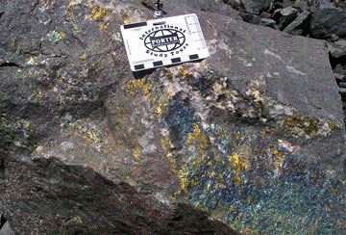
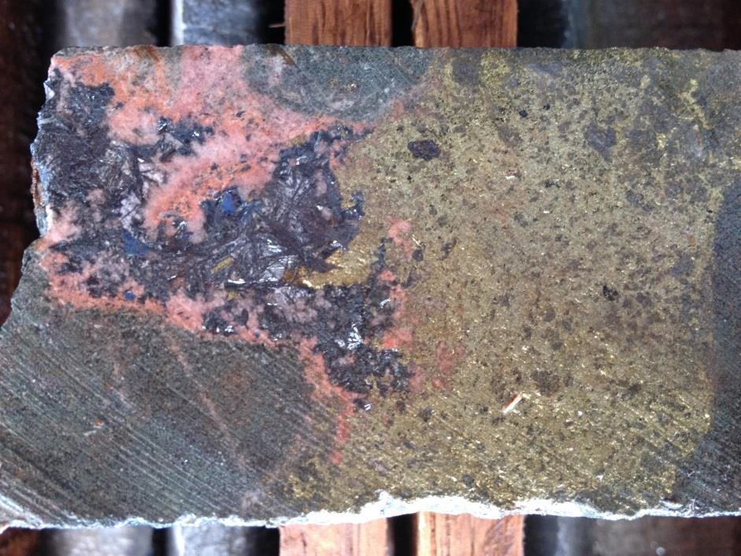
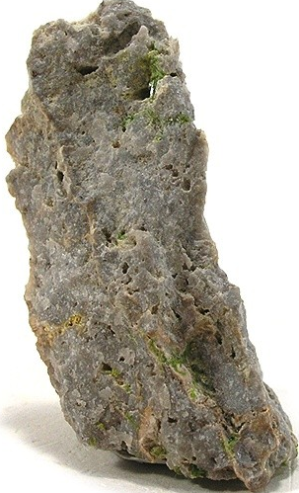
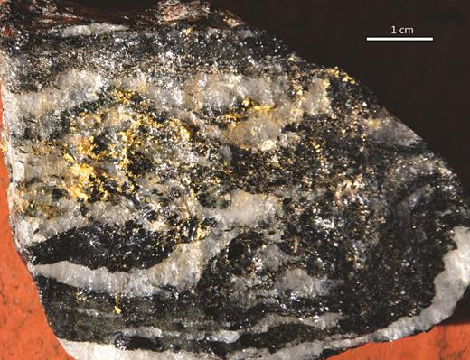
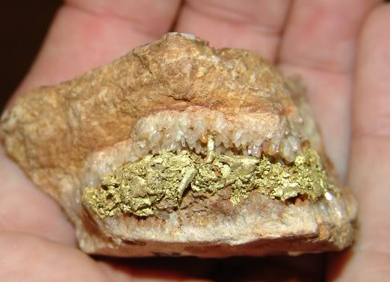
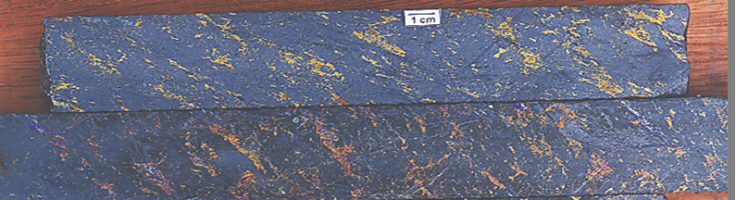
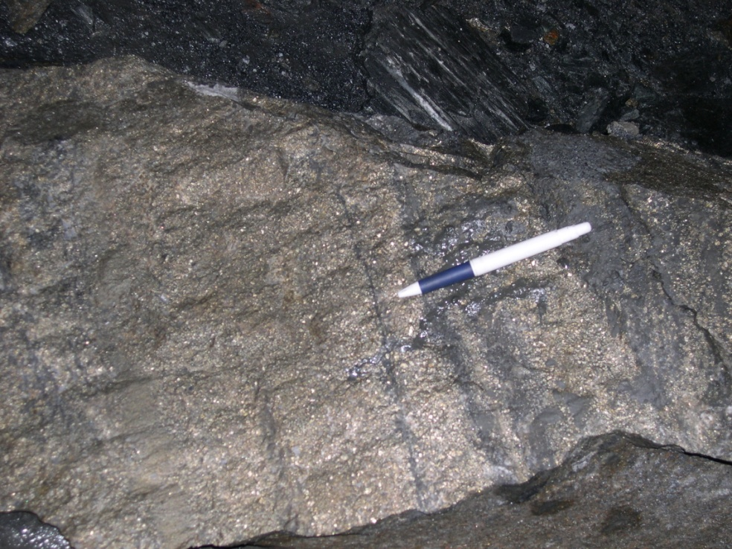
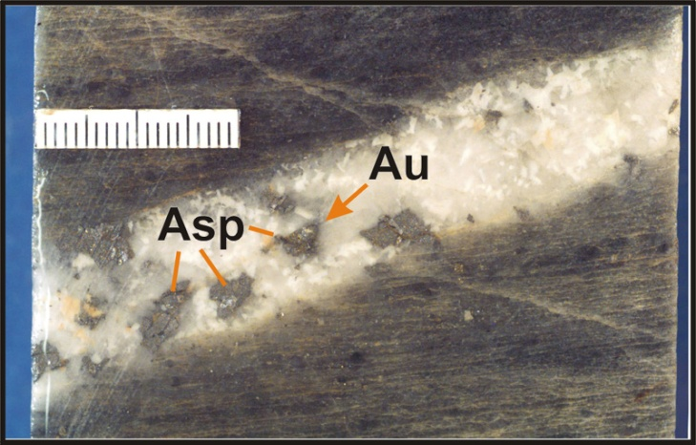
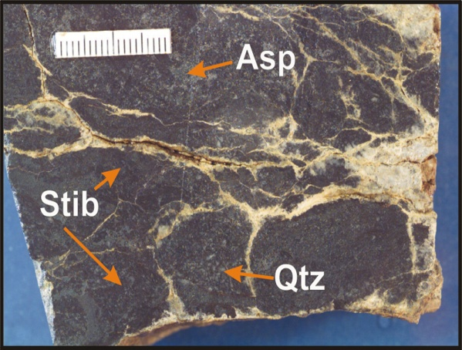
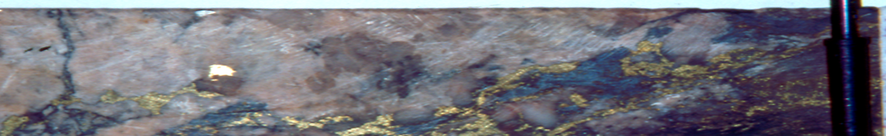
LS Epithermal
IOCG
Eskay Creek, Canada
VMS aurífero
HS Epithermal
Jasperoide, Carlin-type
http://www.boresightminerals.com/wp-content/uploads/2014/06/Jasperoid-1a.png
Intrusion related gold - Yukon
http://www.smm.co.jp/E/special/quickguide/business.html
Magnetite-chalcopyrite ore, Ernest Henry
Metallic band adjacent the coin is electrum. The coppery looking band is chalcopyrite. Sample Heritage Gold Ltd.
https://www.google.com.br/search?q=visible+gold+in+mesothermal+quartz&source=lnms&tbm=isch&sa=X&ved=0ahUKEwjMyI7x5MDeAhWCC5AKHcjECIUQ_AUIEygB&biw=1920&bih=920#imgrc=mz1BRwGoGk3AnM:
http://www.mirandagold.com/i/maps/cerro-oro/oro007.jpg
https://en.wikipedia.org/wiki/El_Indio_Gold_Belt#/media/File:Rodalquilarite-Alunite-64349.jpg
Au - skarn
Diopside-plagioclase gangue
Potassic alteration
Phlogopite gangue
HS Epithermal - High-grade vuggy quartz vein with pyrite and arsenopyrite from artisanal miner's workings
http://www.portergeo.com.au/tours/iocg2013/iocg2013deposits.asp
Mass of electrum plates coating comb quartz, Four in Hand mine near Coromandel
Ig. Bahia
Vein-hosted mineralization ( medium temperature )
Mushketovite at the Bacaba IOCG
deposit, Carajás, drilcore DH00052 (R. Xavier)
Cuiabá
HS Epithermal - Tambo mine with gold-alunite-rodalquilarite mineralization
Chalcopyrite ore in magnetitite
Alemão
Au
Feldspar-rich breccia. Chalcopyrite at the expense of magnetite. Free gold grain.
https://www.jaxonmining.com/site/assets/files/1144/1050825_ted.jpg
https://www.google.com.br/search?q=visible+gold+in+mesothermal+quartz&source=lnms&tbm=isch&sa=X&ved=0ahUKEwjMyI7x5MDeAhWCC5AKHcjECIUQ_AUIEygB&biw=1920&bih=920#imgrc=d48YsrT3iONSKM:
Tension vein
Fault vein
http://www.paydirt.co.nz/forums/yaf_postst416_Hauraki-Gold-field--Hard-rock-gold--aka-electrum.aspx#post3470
http://www.adimb.com.br/simexmin2012/wpcontent/themes/simexmin/palestras/03%20-%20SEG/II_3_Garzon.pdf

Slide 10
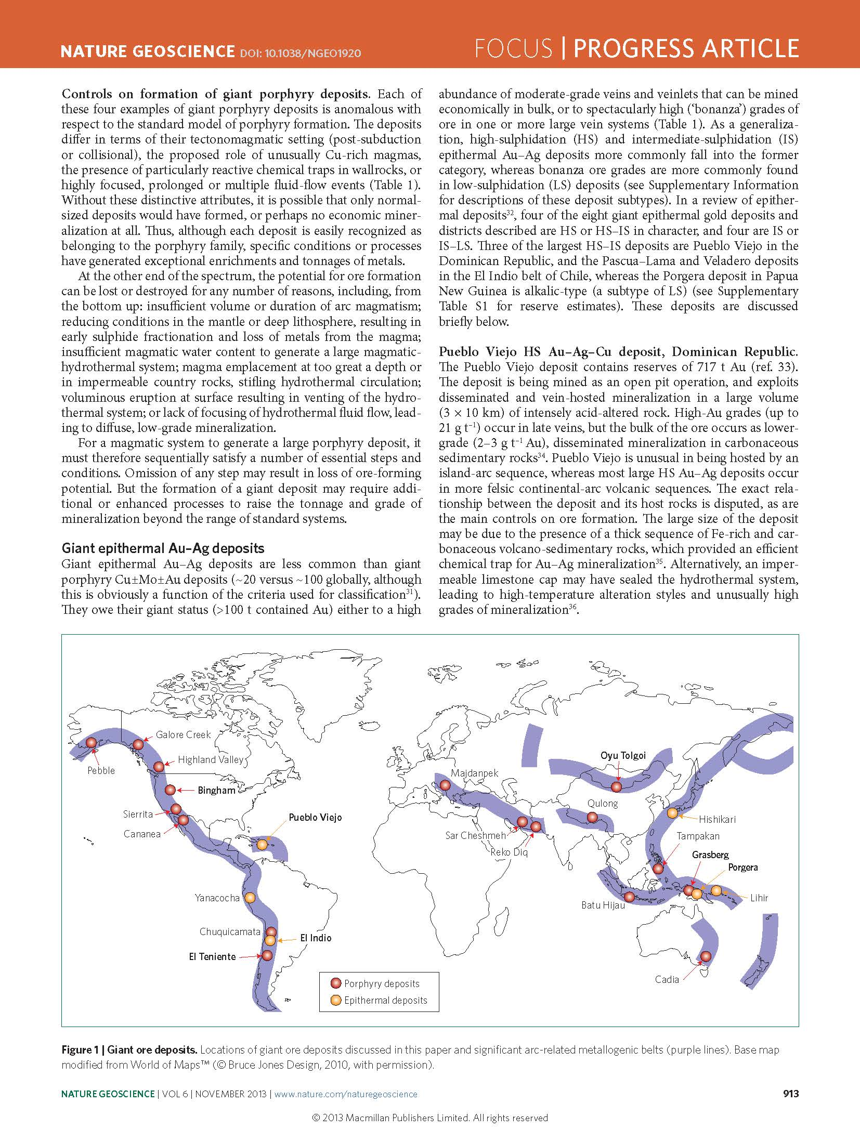
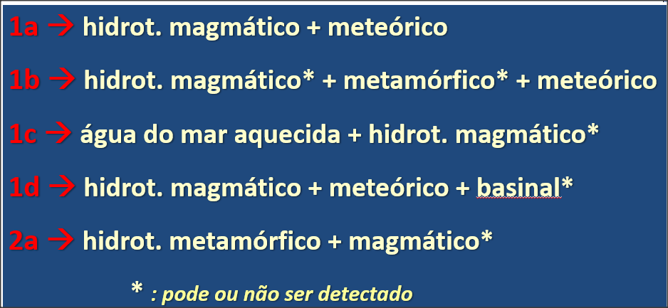
1a
Richards et al. (2013)

Slide 11
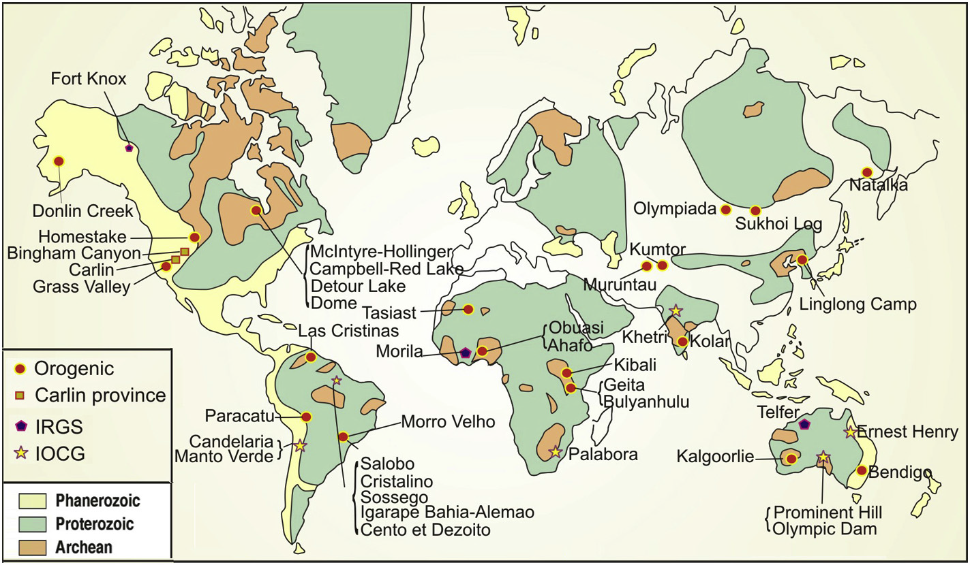
Giant orogenic, Carlin-type, IRGD and IOCG gold deposits
>250 tonnes or >7.5moz gold, for gold-equivalent forAu-Cu IOCG deposits
Schematic world map showing interpreted age of basement rocks and distribution of giant orogenic gold, Carlin-type, IRGD and IOCG deposits. Figure adapted from Goldfarb et al. (2005) and Groves et al. (2010).

Slide 12
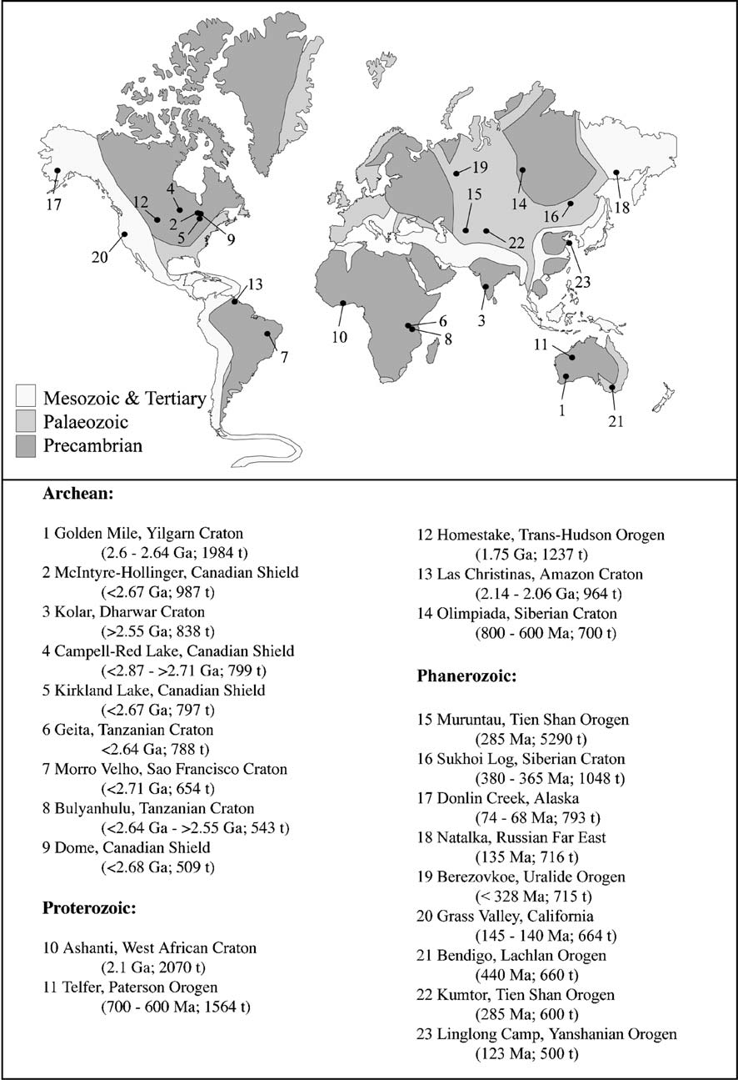
2a
Bierlein et al. (2006)
Distribution of terranes of various ages, and location of 23 known giant orogenic gold deposits/districts.

Slide 13
Outros: Serra Pelada (substituição rochas sedimentares); Tocantinzinho , Palito, Cuiu-Cuiu (porfirítico); Chapada (porfirítico metamorfisado); São Jorge (tipo epitermal); Jacobina (metaconglomerado).
IOCGs: Salobo, Sossego, Cristalino, Igarapé, Alemão, 118
Turmalina
São Sebastião
Salobo
Orogênicos: Volta Grande, Morro do Ouro, Crixás, Posse, Pilar, Tucano, Aurizona, Gurupi, São Francisco
Cuiabá
Morro Velho
Sossego
Faria
Bicalho
Cristalino
Caeté
Igarapé-Bahia
Córrego do Sítio
Breves
Lamego
Alemão
São Bento
Raposos
,
Maquiné
Serra Pelada
Passagem de Mariana
118
Gongo Soco-Itabira
Riacho dos Machados
Almas
C1 Santa Luz
Volta Grande
Jacobina
São Francisco (Borbor.)
Cachoeira
Tocantinzinho
Gurupi
Cuiú-Cuiú
Aurizona
Palito
São Jorge
Tucano
Morro
do Ouro
Orogênicos: C1, Almas, Riacho dos Machados, Passagem de Mariana, Raposos, São Bento, Lamego, Córrego do Sítio, Caeté, Morro Velho, Cuiabá
Chapada
Cajueiro
Pilar
Crixás
Posse
Lobato et al. (2016), Academia Brasileira de Ciências; cap de livro: “Recursos Minerais no Brasil

Slide 14
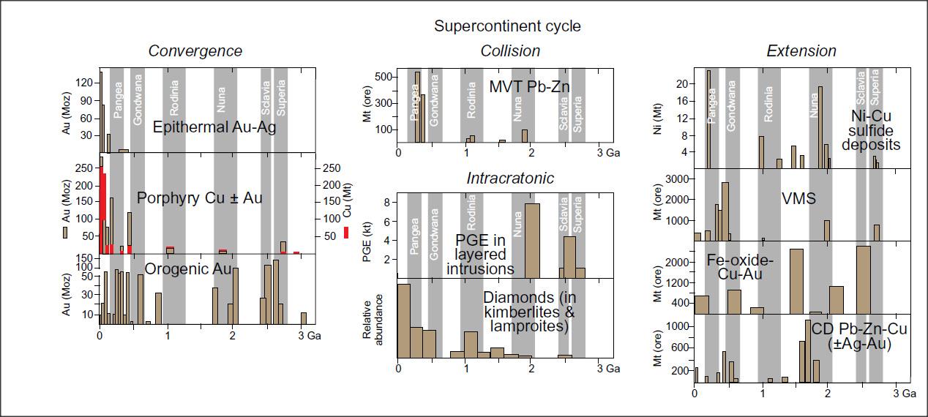
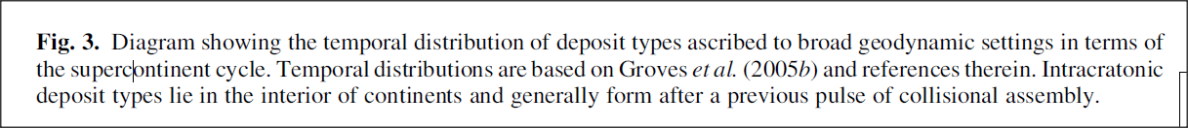
Plate tectonic and ore-forming processes operated in the Archaean similarly to today. Secular variation in metallogenic potential in Archaean cratons made them more richly endowed in some types of mineral deposits than younger terrains, reflecting more efficient transfer of elements from the mantle to the continental lithosphere (De Wit & Thiart 2005).
Although only 6% of the continental lithosphere is Archaean, it contains ~25% of all gold resources (in Cawood & Hawkesworth, 2016).
Cawood & Hawkesworth (2016)
Notes:
9

Slide 15
Depósitos de Ouro:
Produção
Investimentos
Maiores minas
História
Questões exploratórias …

Slide 16
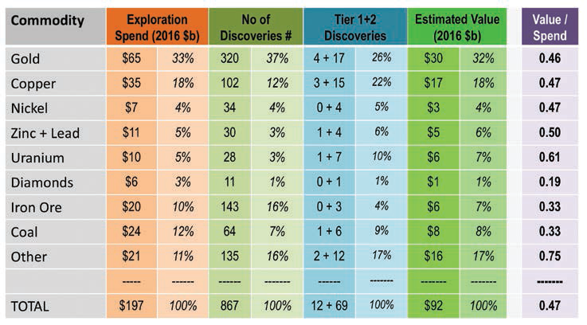
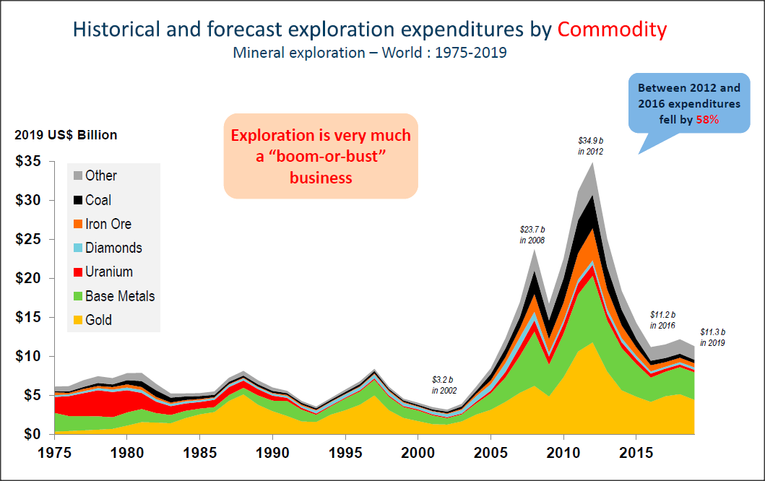
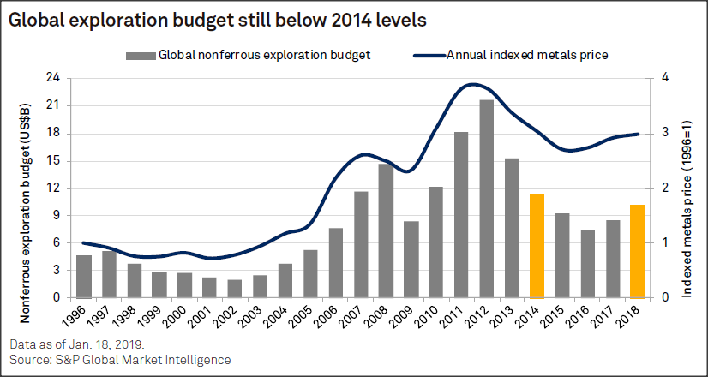
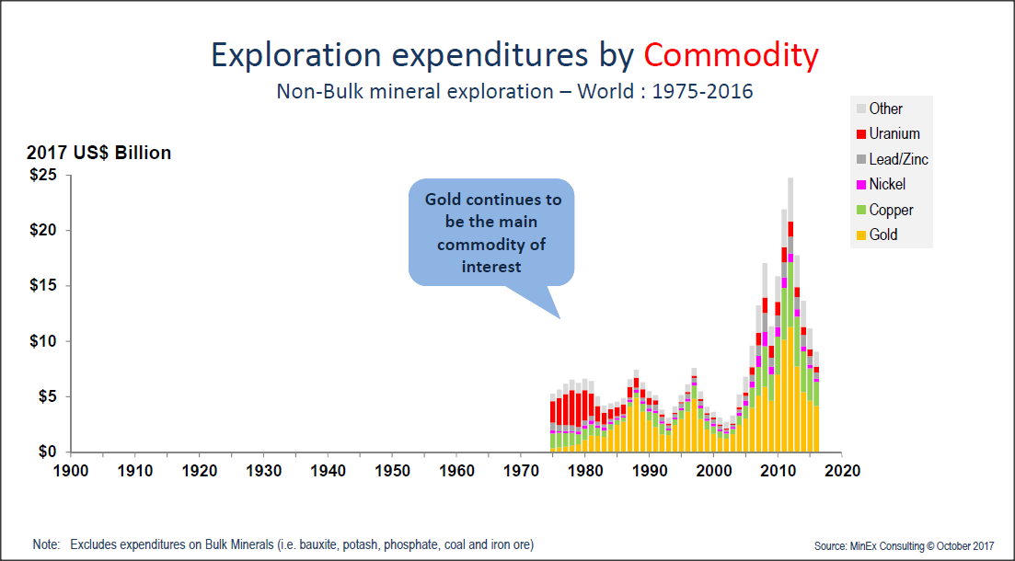

Since 2012
 Discovery rates → declining
 Costs → rising steeply → all-time high, ~ 3x 2005
 Financing → restricted
Mas antes …..
→ mineral exploration crisis
http://minexconsulting.com/wp-content/uploads/2019/12/IMARC-Presentation-27-Oct-2019-FINAL.pdf
Dan Wood AO, SEG NewsLetter 12, Jan 2018

Slide 17
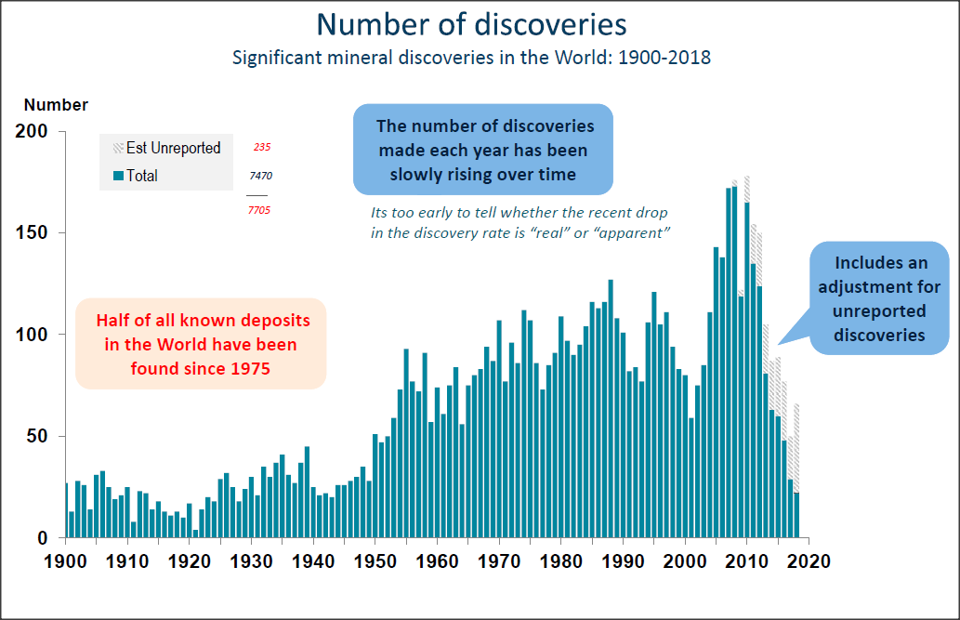
http://minexconsulting.com/wp-content/uploads/2019/12/IMARC-Presentation-27-Oct-2019-FINAL.pdf

Slide 18
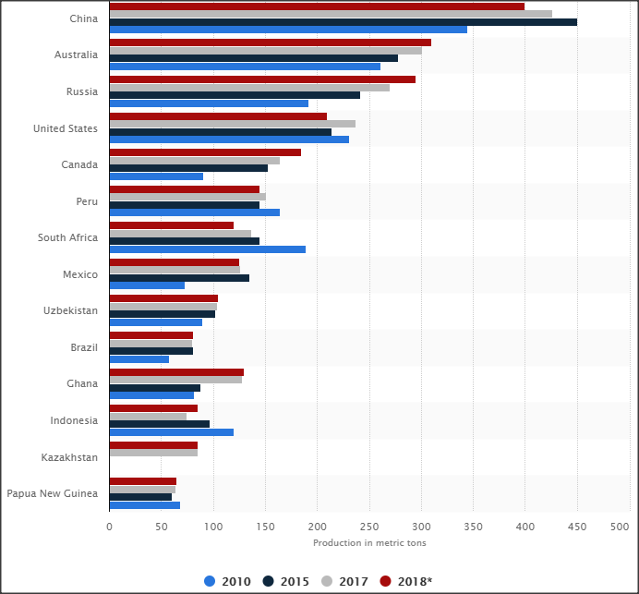
Agora ouro …..
Major countries (14) in mine production of gold worldwide from 2010 to 2018 (in metric tons)
https://www.statista.com/statistics/264628/world-mine-production-of-gold/

Slide 19
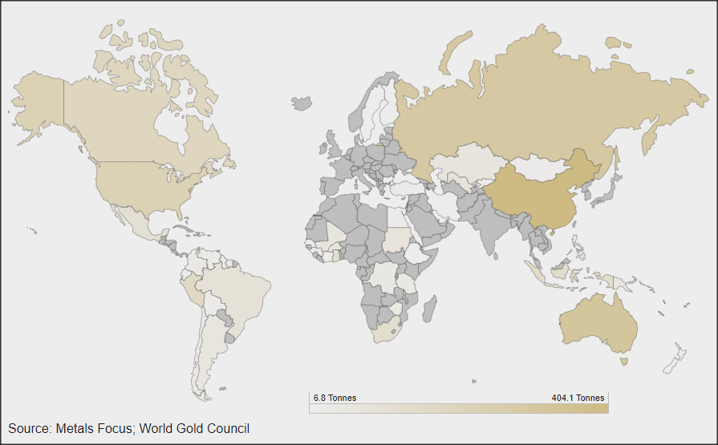
Relative production of gold 2018, published April 4th 2019
https://www.gold.org/goldhub/data/historical-mine-production
Gold mining → global business with operations on every continent, except Antarctica, and extracted from mines of widely varying types and scales.
At country level → China largest producer in 2018, with 12% of total global production. This interactive gold mining map demonstrates the geographical dispersion of gold mining operations.

Slide 20
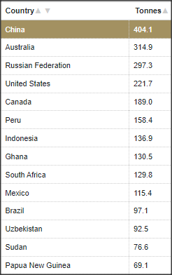
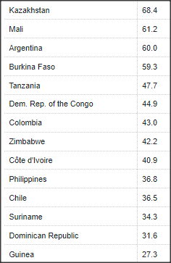
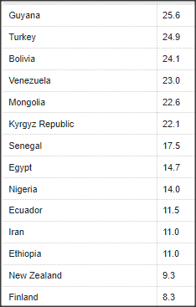

https://www.gold.org/goldhub/data/historical-mine-production

Slide 21
All-time world Au production
1a
1c
Clástico & 2a
IOCG 1d
2a
Based upon 175 000 t gold produced to the end of 2013. Plenty of scope for different interpretations of what should be in each sub-category of gold-only production.
2a
1a
Some well-known deposit types. Although useful and widely used, scheme does not meet full requirements of ideal classification scheme.
(i) 80% of production from gold-only deposits, i.e., no economic base metals (shades of green);
(ii) <¼ from deposits with co-product or by-product base metals (red and orange colours).

Slide 22
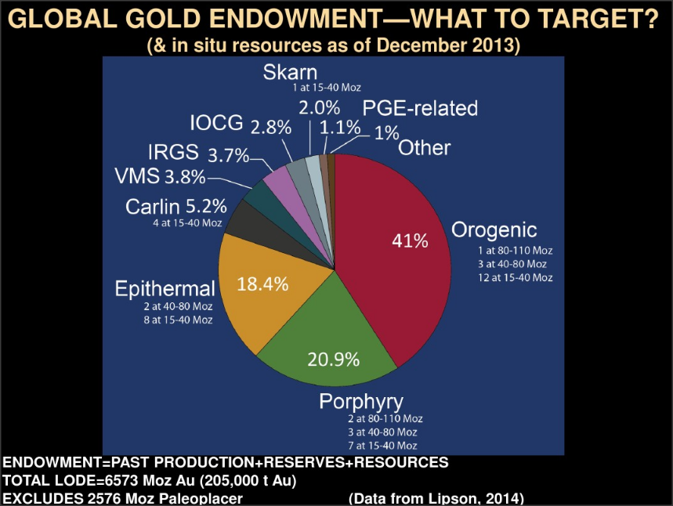
1b
2a
1a
1a

Slide 23
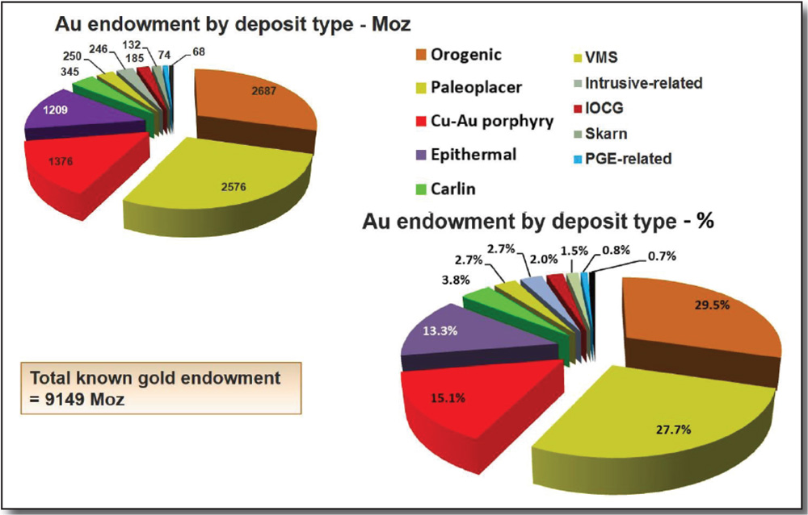
Outros: Serra Pelada (substituição rochas sedimentares); Tocantinzinho , Palito, Cuiu-Cuiu (porfirítico); Chapada (porfirítico metamorfisado); São Jorge (tipo epitermal); Jacobina (metaconglomerado).
IOCGs: Salobo, Sossego, Cristalino, Igarapé, Alemão, 118
Gold deposit type endowments
Turmalina
São Sebastião
Salobo
Orogênicos: Volta Grande, Morro do Ouro, Crixás, Posse, Pilar, Tucano, Aurizona, Gurupi, São Francisco
Cuiabá
Morro Velho
Sossego
Faria
Bicalho
Cristalino
Caeté
Igarapé-Bahia
Córrego do Sítio
Breves
Lamego
Alemão
São Bento
Raposos
,
Maquiné
Serra Pelada
Passagem de Mariana
118
Gongo Soco-Itabira
Orogenic & Paleoplacer: ~ metal endowments, at 29% and 28%, respectively.
Porpyhry → 15%, plus Epithermal → 28%;
Carlin → 3.8%
Riacho dos Machados
Almas
C1 Santa Luz
Volta Grande
Jacobina
São Francisco (Borbor.)
Cachoeira
Tocantinzinho
Gurupi
Cuiú-Cuiú
Aurizona
Palito
São Jorge
Tucano
Morro
do Ouro
Orogênicos: C1, Almas, Riacho dos Machados, Passagem de Mariana, Raposos, São Bento, Lamego, Córrego do Sítio, Caeté, Morro Velho, Cuiabá
Chapada
Cajueiro
Pilar
Crixás
Posse
Lobato et al. (2016), Academia Brasileira de Ciências; cap de livro: “Recursos Minerais no Brasil

Slide 24
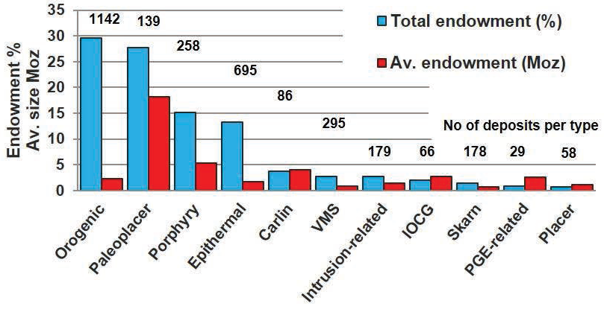
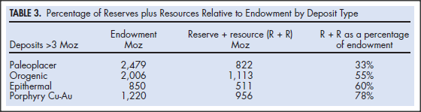
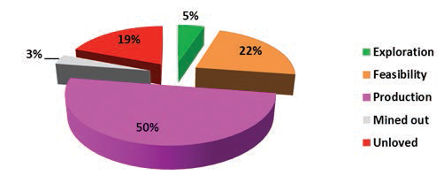
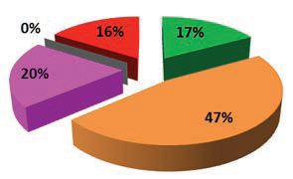
“Unloved”: deposits where resources have been stated for > 10 years, yet project is still not moving toward the construction stage, OR mining stopped prematurely due to local protest
Gold deposit type average sizes
Orogenic gold reserves plus resources for deposits with ≥3 Moz, subdivided by development stage.
Porphyry Cu-Au gold reserves plus resources for deposits with ≥3 Moz, subdivided by development stage.

Slide 25
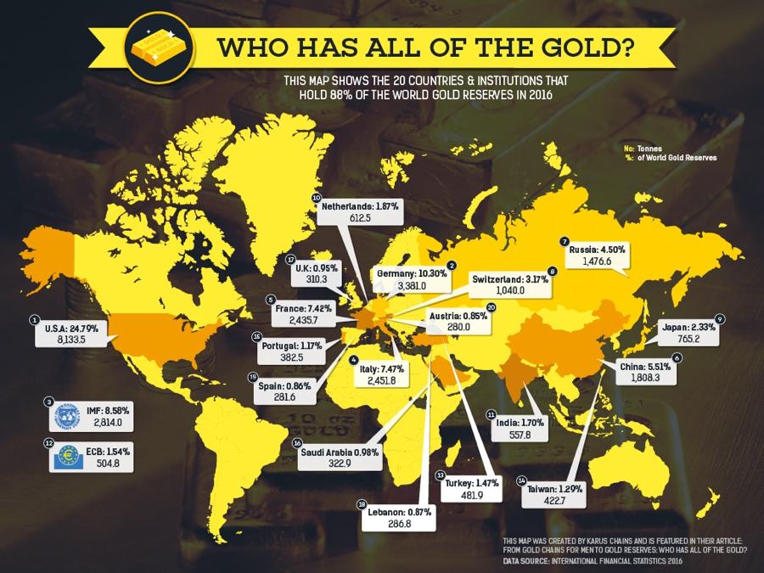
88% of the total gold reserves is held by only 20 countries (in %):
https://www.mining.com/web/this-map-shows-you-which-countries-have-most-of-the-worlds-gold/

Slide 26
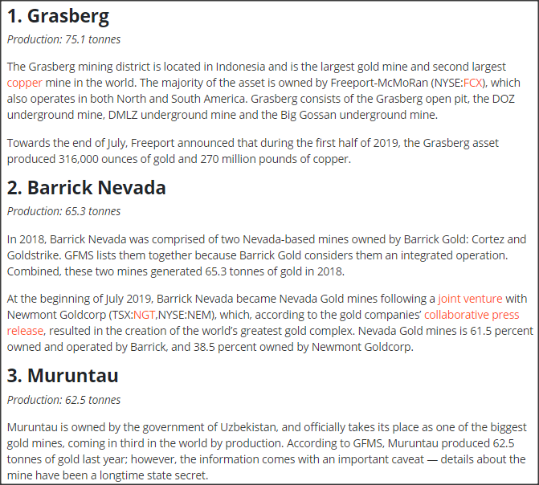
Top 10 Gold Mines
PORPHRY COPPER-type
CARLIN-type
https://investingnews.com/daily/resource-investing/precious-metals-investing/gold-investing/largest-gold-mines/
OROGENIC (intrusion-related)

Slide 27
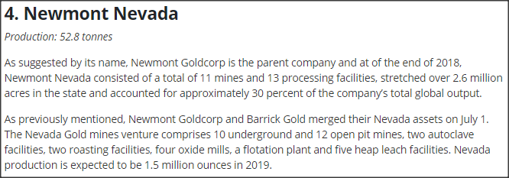

CARLIN-type
Top 10 Gold Mines
https://investingnews.com/daily/resource-investing/precious-metals-investing/gold-investing/largest-gold-mines/
OROGENIC

Slide 28


Top 10 Gold Mines
Transition PORPHRY GOLD-type to LS GOLD-type
HS GOLD-SILVER-type
https://investingnews.com/daily/resource-investing/precious-metals-investing/gold-investing/largest-gold-mines/

Slide 29

Top 10 Gold Mines
OROGENIC
https://investingnews.com/daily/resource-investing/precious-metals-investing/gold-investing/largest-gold-mines/
ALKALIC PORPHRY GOLD-COPPER-type

Slide 30



 Between 2007 and 2016 → US$65 billion to discover US$30 billion in 320 gold deposits
 Only 4 > 6 Moz, and only 17 of the smaller discoveries contained more than 1 Moz
 Gold exploration → more directly exposed to investor confidence (compared to Cu…)
 From shallow to deep
http://minexconsulting.com/wp-content/uploads/2019/12/AusIMM-Long-term-trends-in-gold-Explorn-Nov-2019-1.pdf
Rate of gold deposit discovery relative to exploration expenditure: number of reported discoveries and estimated unreported discoveries

Slide 31


http://minexconsulting.com/wp-content/uploads/2019/12/AusIMM-Long-term-trends-in-gold-Explorn-Nov-2019-1.pdf
https://www.spglobal.com/marketintelligence/en/documents/world-exploration-trends-march-2019.pdf

Slide 32



http://minexconsulting.com/wp-content/uploads/2019/12/AusIMM-Long-term-trends-in-gold-Explorn-Nov-2019-1.pdf

Slide 33



 Major companies discontinued exploration in late 1980s
 Separate small gold companies were created, and sizes of producing companies and their annual productions grew significantly
 As a result, so did the demand to discover larger quantities and in larger deposits
 Bulk mining widely applied from the late 1970s. New ore processing and recovery methods (cyanide heap leaching and activated carbon recovery) → reduction in average grade
Size & Grade
http://minexconsulting.com/wp-content/uploads/2019/12/AusIMM-Long-term-trends-in-gold-Explorn-Nov-2019-1.pdf
Average grade of gold mined worldwide recently dropped to 1.8 g/t from 7.3 g/t in 1979. Average grade of new gold discoveries is just 0.76 g/t. High-grade deposits (> 5 g/t) will be targets for future exploration because of geographical restrictions, desire to preserve profit margins, and smaller environmental footprint that increases chance of securing community approval and permits
Ore grade in g/t gold versus metric tonnes of ore for giant deposits (orogenic, Carlin-type, IOCG and IRGD gold deposit groups). For IOCG deposits, grade is shown as g/t gold-equivalent, which utilizes current gold and copper prices to calculate copper value as gold equivalent value (Groves & Santosh 2016).

Slide 34

Size & Grade
No giant deposits <~ 50 Ma
(Goldfarb & Groves , 2015)
Grade–tonnage for the largest orogenic gold deposits as reported by USGS about 25 years ago, as well as resource as of 2013. Plotted USGS Phanerozoic data are quite low in tonnage because these are reported as three orders of magnitude too low; they should overlap Precambrian deposits of Klein and Day (1994), between 100 and 1000 tonnes Au. Importantly, over time, industry has moved from mining high-grade, mainly vein-hosted ores to today's low-grade, higher tonnage ores that include large volumes of altered wallrock. Present-day orogenic gold resources are becoming similar to resources reported for giant gold-rich porphyry deposits.

Slide 35






 Possibly, decline in discovery over the past decade not related to mineral potential ….
♦ Actually, stock market boomed → overexpenditure before deciding to abandon project → input costs (e.g., salaries, drilling, energy, regulatory reporting, etc.) escalated sharply … juniors
♦ Computers in exploration vs conducting meaningful field work
♦ Corporatization → numerous bureaucratic, regulatory (lawyers!) and social requirements, etc., at the expense of creative thinking essential for discovery. Corporate responsibilities that must however be addressed by geologists!!!!
So, why not find gold like we did before 2005????
http://minexconsulting.com/wp-content/uploads/2019/12/AusIMM-Long-term-trends-in-gold-Explorn-Nov-2019-1.pdf
Dan Wood AO, SEG NewsLetter 12, Jan 2018

Slide 36

So, why not find gold like we did before 2005????
 Possibly related to technical reasons
♦ Most of more obvious and easily discovered near-surface deposits have been located
♦ Focus directed mainly at depths amenable to mining by open pit, mainly in more mature terrains
♦ Development of new deposit models → reduce discovery risk by more accurately forecasting proximity to possible ore by studying weakly to non-mineralized altered rocks
Dan Wood AO, SEG NewsLetter 12, Jan 2018
 From shallow to deep
http://minexconsulting.com/wp-content/uploads/2019/12/AusIMM-Long-term-trends-in-gold-Explorn-Nov-2019-1.pdf

Slide 37


The future of gold exploration is under cover
http://resourceworld.com/index.php/the-future-of-gold-exploration-is-under-cover/

Slide 38

What about the Wits factor… ??
Decline of Witwatersrand gold from peak of 1,000 tonnes (t) in 1970 to only 220 t in 2008. After dominating the world gold scene for 125 years, this raises the question: where growing demand gap for gold will be coming from? Which deposit types?
 Waning Witwatersrand gold production → porphyry deposits become progressively more important as gold source, as well as epithermal deposits.
 Orogenic deposits have 50% of reserves & resources in production → warrant all local brownfields exploration mines can afford. Many small orogenic gold deposits → relatively good chance to make further local discoveries as additions to existing mining infrastructure.
 Porphyry Cu-Au deposits → more sensitive to grade than size.
As multimetal deposits → provide better “insurance” against swings in any single metal price.
Downside → high costs of acquisition, exploration, and construction

Slide 39


Thinking mineral systems …
Carefully consider scale at which exploration targets are viewed → assess potential of drill targets in terms of terrane to province to district scale, rather than deposit scale, where most current economic geology research and conceptual thinking is concentrated.
Orogenic, IRGD, Carlin-style and IOCG gold-rich systems → different at deposit scale, but with increa-singly similar source-region parameters at lithosphere scale (common tectonic settings). Targets adjacent to craton margins, other lithosphere boundaries, and suture zones favoured for all these gold deposits.
Exploration could lead to incidental discovery of major deposits of other metals along the same tectonic boundaries.
General mineral systems model
Tectono-metallogenic systems → geological systems that link geo-dynamic and tectonic processes with ore-forming processes.
Focus on processes that place across different mineral systems, and not those specific to one style of deposit.

Slide 40

2a
1a
1b
1a
1d
Deposit-scale mineral system models for orogenic, IRGD, Carlin-style, Bingham Canyon and IOCG gold (-Cu) deposits showing contrasts in many parameters at this scale.

Slide 41

General mineral systems model – Ex. Orogenic Au
The target deposit is thought of as a dynamic system that has affected the regional and local geology around the orebody

Slide 42
10 ingredients that can enhance chances of discovery:
People; Good science (geology); Experience; Intuition; Creativity; Perseverance; Visualisation; Serendipity; Mineral systems approach; and Drilling (Groves & Trench, 2014).
Deeper mining
Change in exploration and mining strategy
Young geologists and geological engineers must receive training in field skills along
with education in new technology of exploration and mining, and economic geology
Industry/associations should seek to promote mentorship of graduate and under-
graduate students, mainly in the field, and offering short courses etc.
Need for generic strategy of formal alliances between majors and high-quality juniors
Geologically, exploration: (i) targets to be viewed in terms of their geochronological suitability of host rocks and potential ore type in terms of the supercontinent cycle and regional geodynamics; (ii) prospects to be assessed in terms of the suitability of their terrane- or province-scale tectonic setting

Slide 43
COVID-19 outbreak
major impact on gold market
massive price swings as investors react to new developments related to the pandemic
many companies suspend production and-or exploration, altering their guidance or making other changes
future?

Slide 44
O vencedor do Prêmio Nobel de medicina de 1937, Albert von Szent- Györgyi, observou:
“uma descoberta consiste em ver aquilo que todos já viram, e pensar naquilo que ninguém ainda pensou”
Obrigada !!

